Slide 1


WELCOME
IN498 – Capstone in Analytics
UPDATED: JUNE 20, 2018

Slide 2

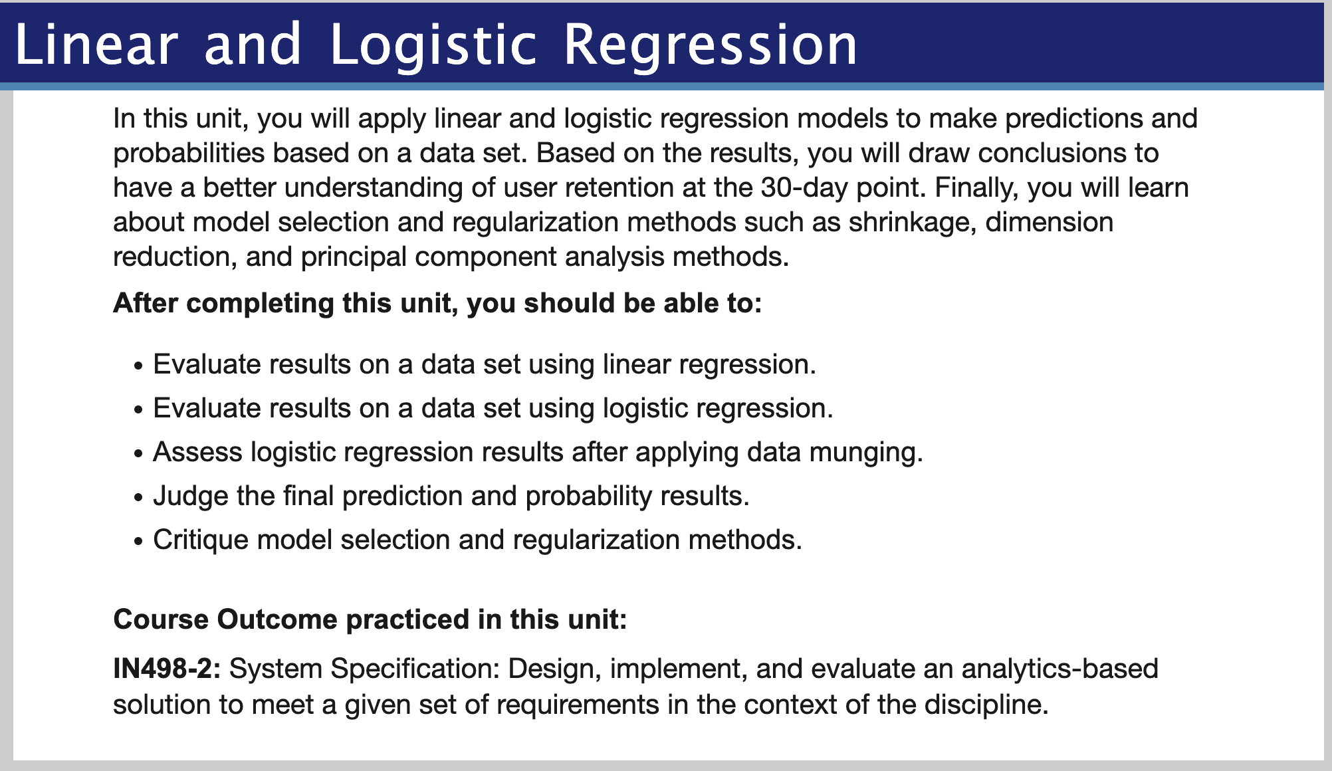
Overview
Purdue University Global |Foundations of Purdue Global Culture

Slide 3
Unit 3
Be sure to review Unit 3 in Brightspace for more details
Reading
-- See next slide
Discussion Question (20 points)
-- See following slides.
Assignment (60 points)
-- See following slides.
Seminar (20 points)
-- Option 1: Attend each week.
-- Option 2: Reflective Assignment.
Purdue University Global |Foundations of Purdue Global Culture

Slide 4
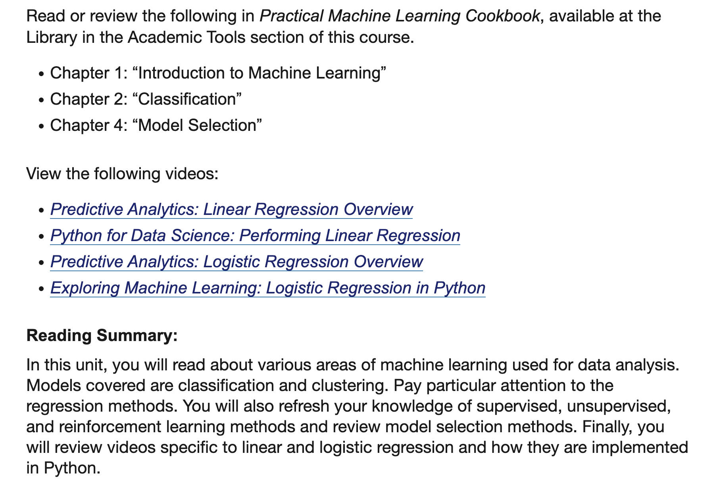
Reading
Purdue University Global |Foundations of Purdue Global Culture

Slide 5
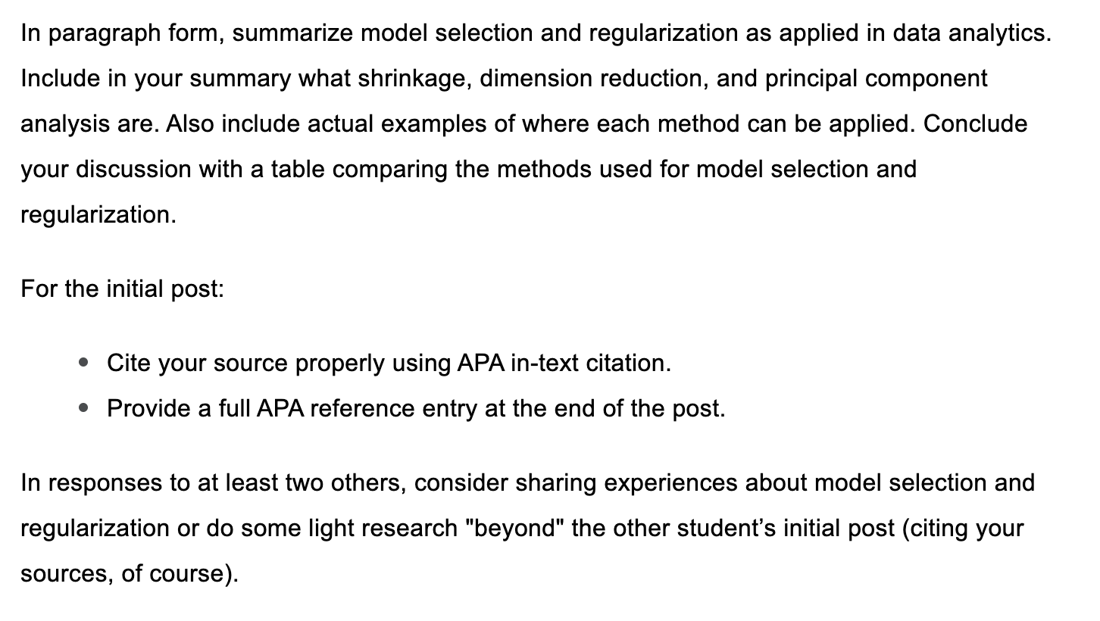
Discussion
Purdue University Global |Foundations of Purdue Global Culture

Slide 6
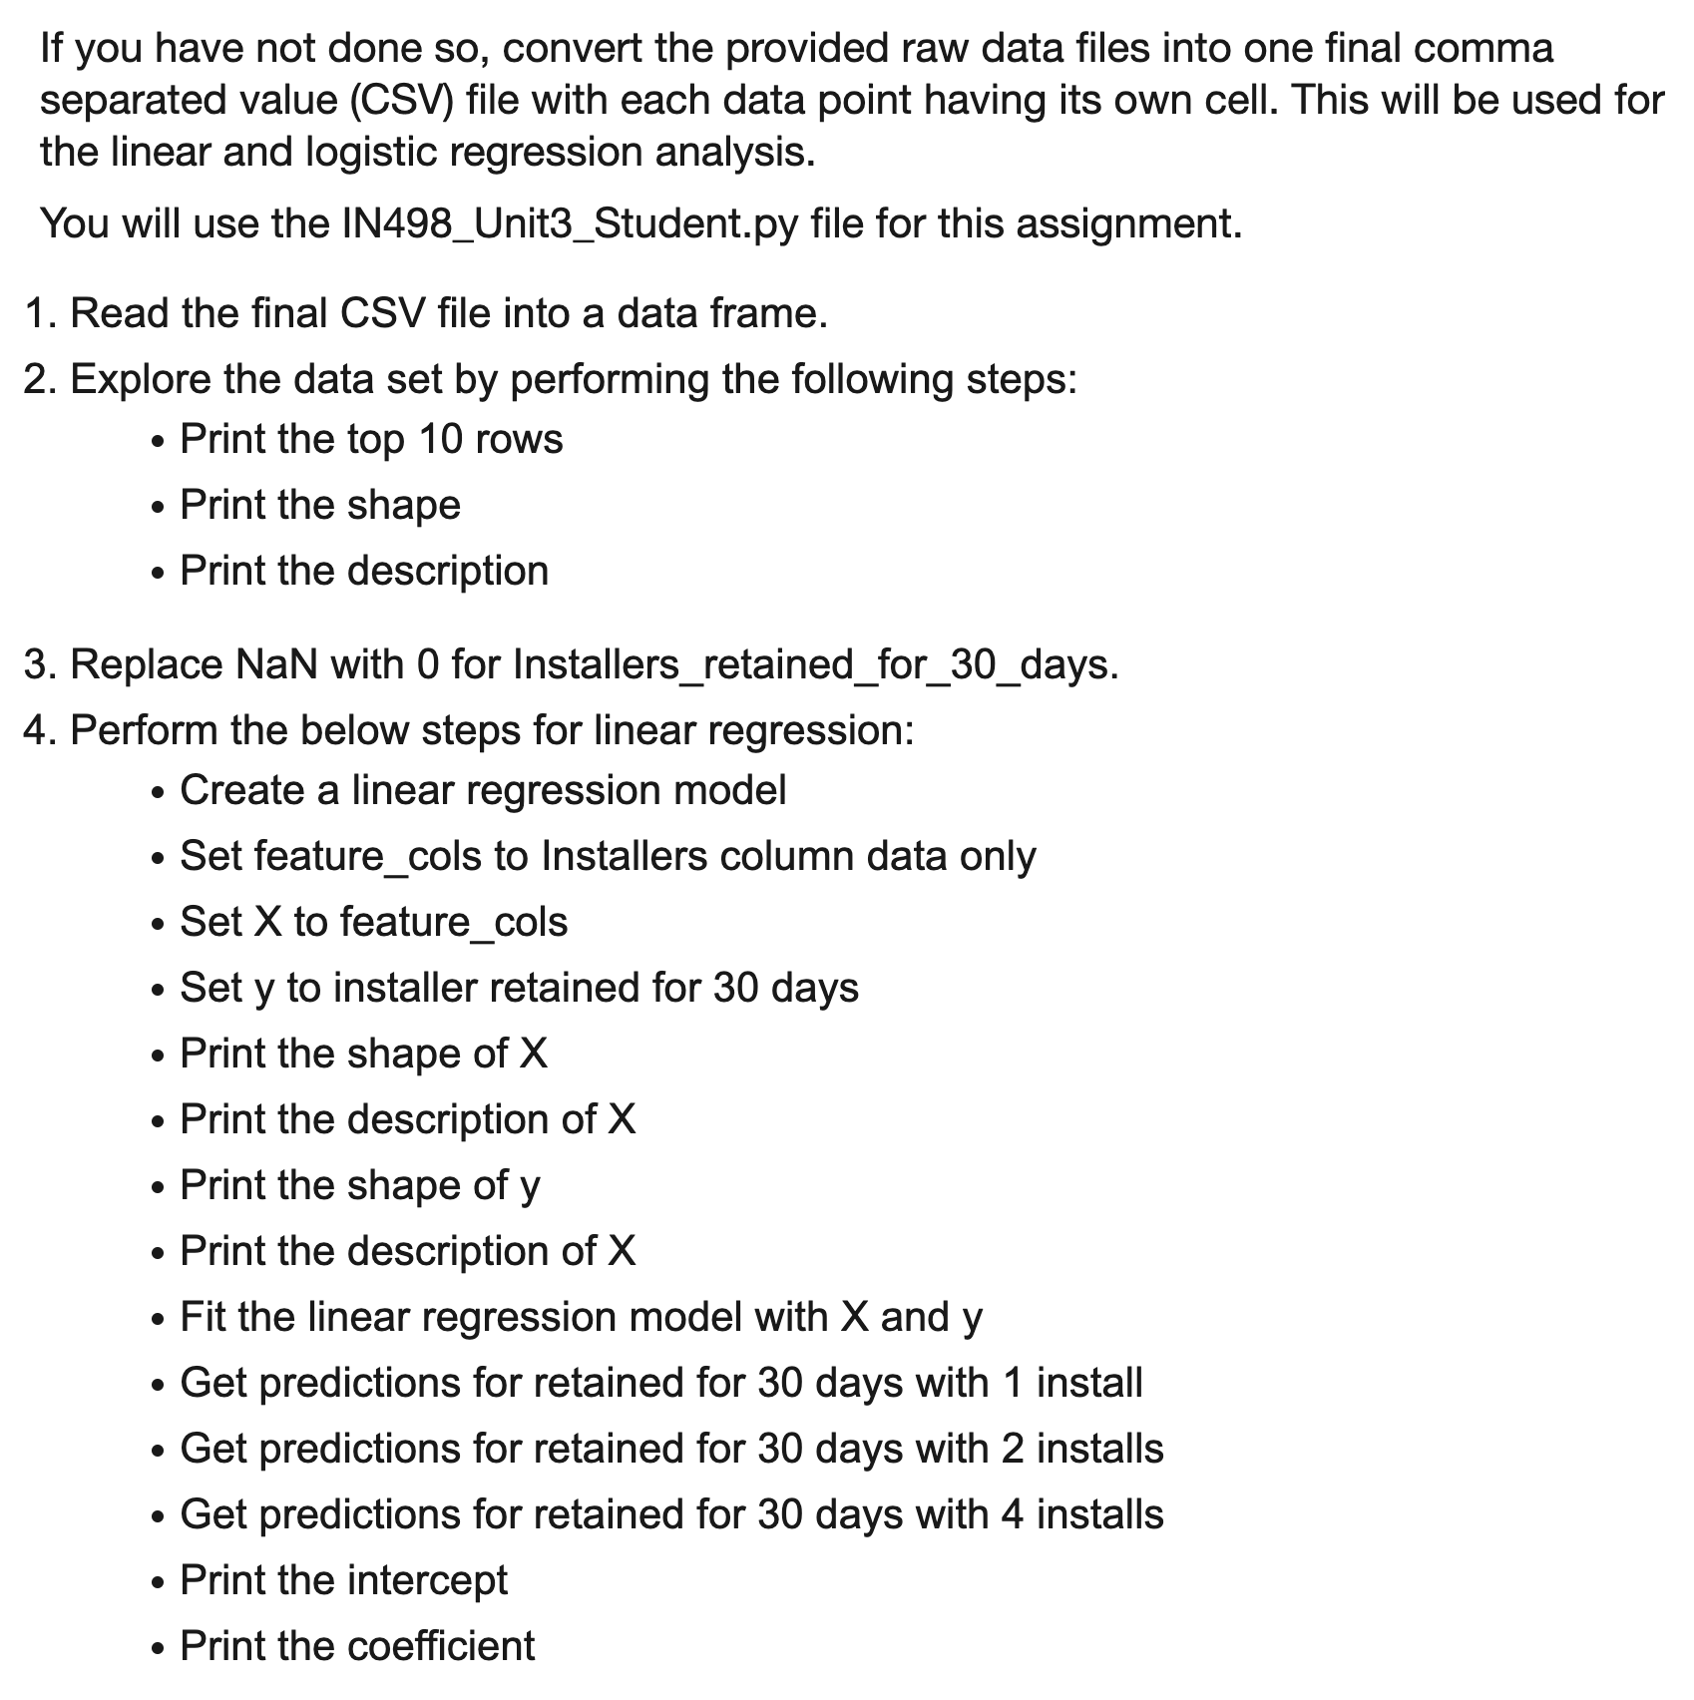
Assignment
Purdue University Global |Foundations of Purdue Global Culture

Slide 7
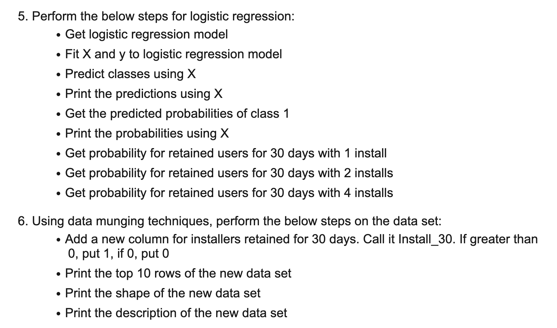
Assignment
Purdue University Global |Foundations of Purdue Global Culture

Slide 8
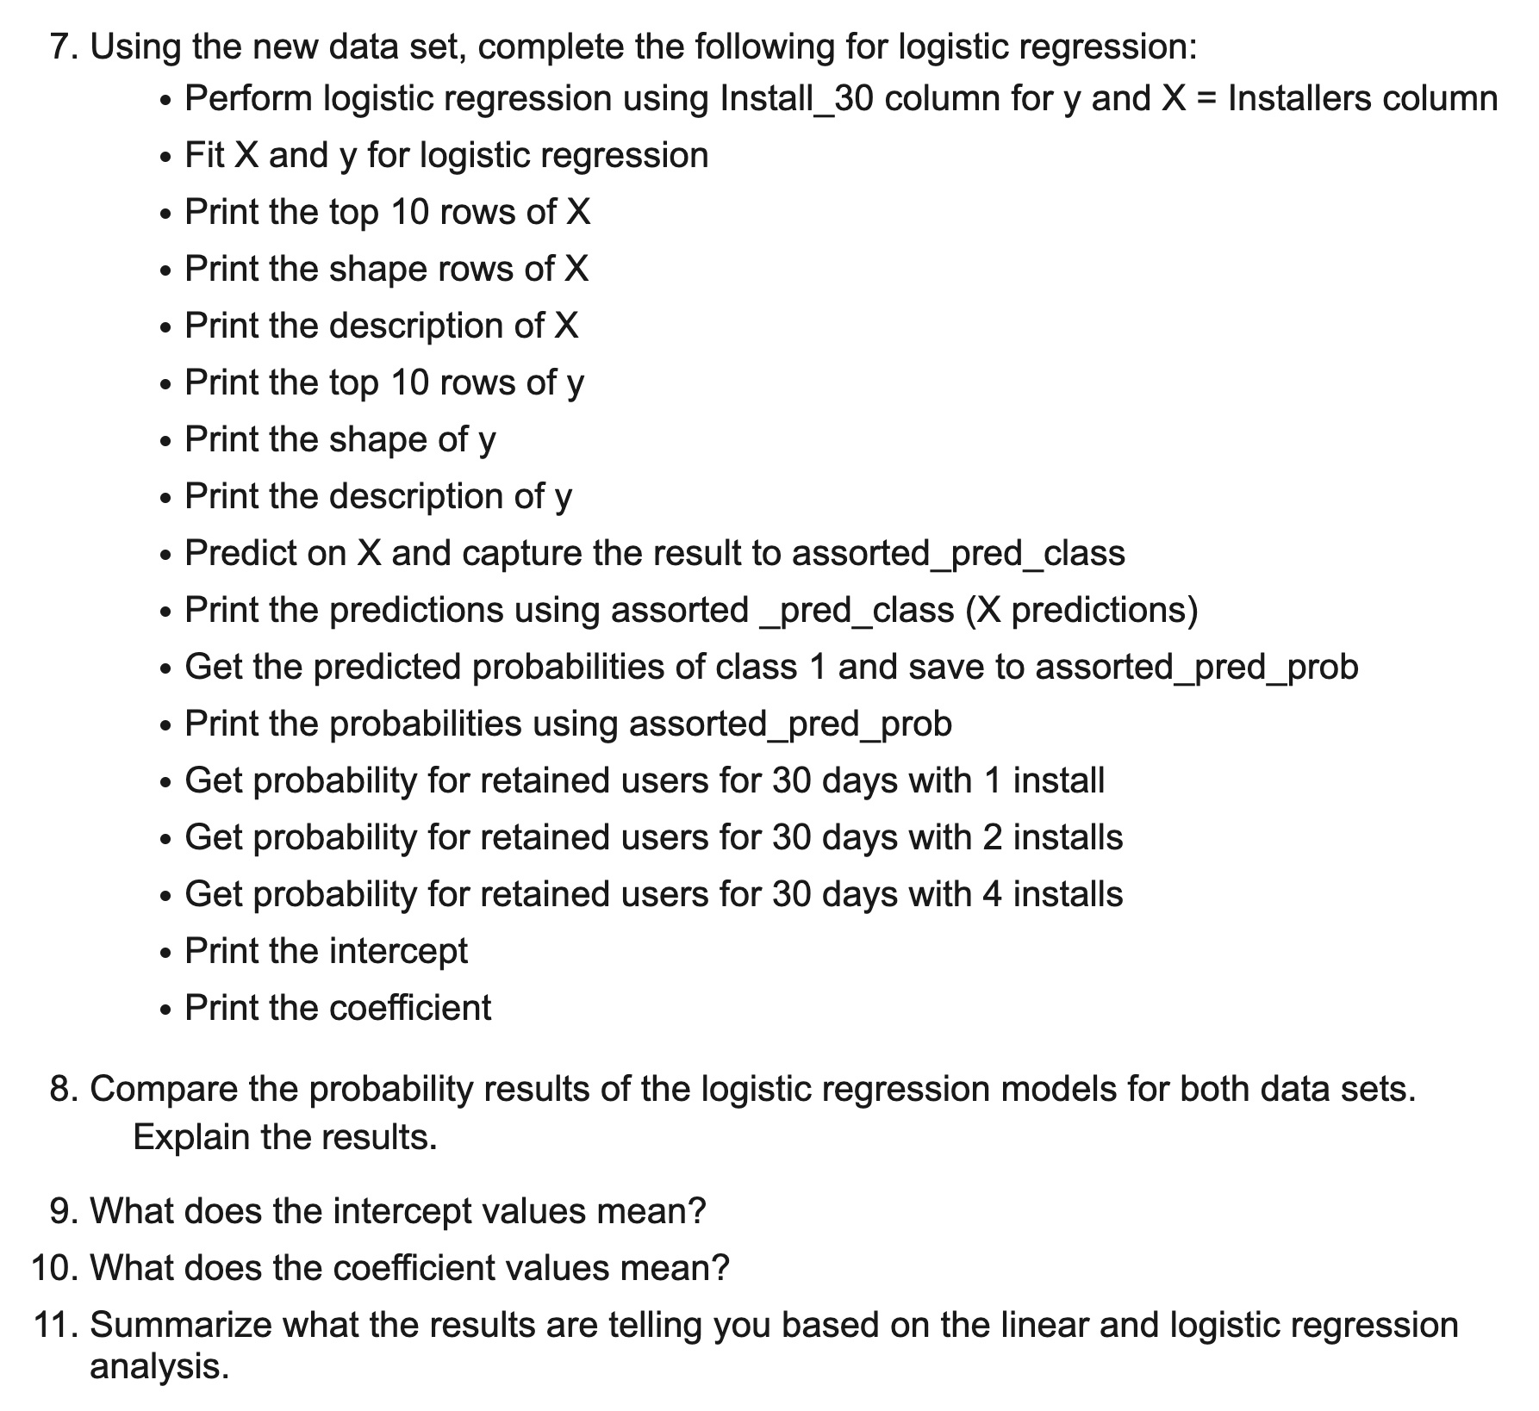
Assignment
Purdue University Global |Foundations of Purdue Global Culture

Slide 9
Assignment Rubric
See document in Course Resources-> Grading Rubrics.
Purdue University Global |Foundations of Purdue Global Culture

Slide 10
Unit 3

Slide 11
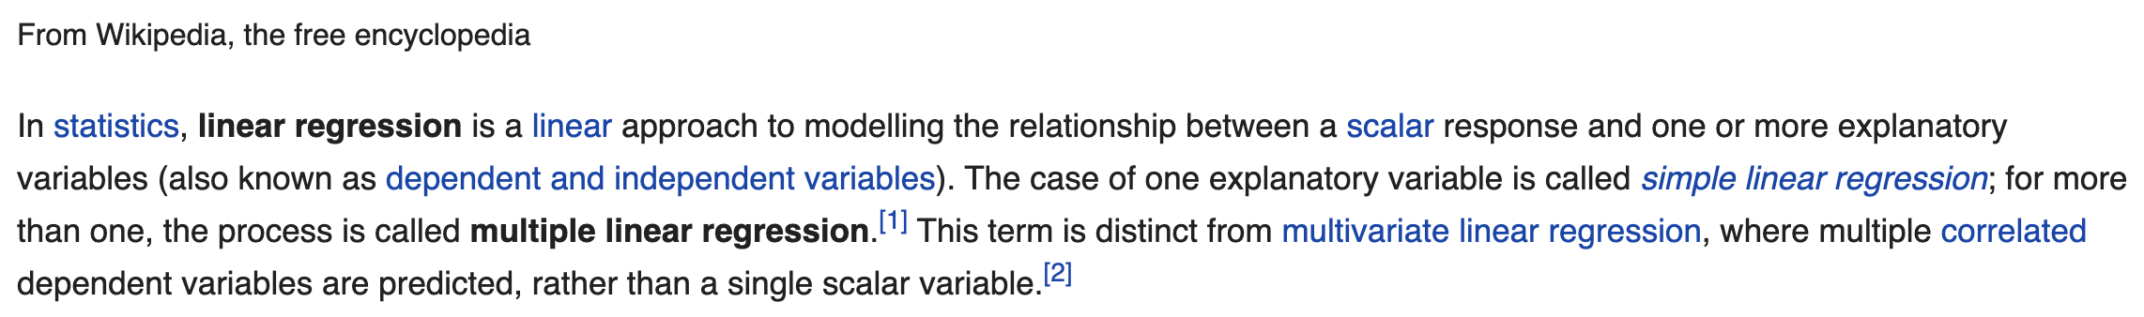
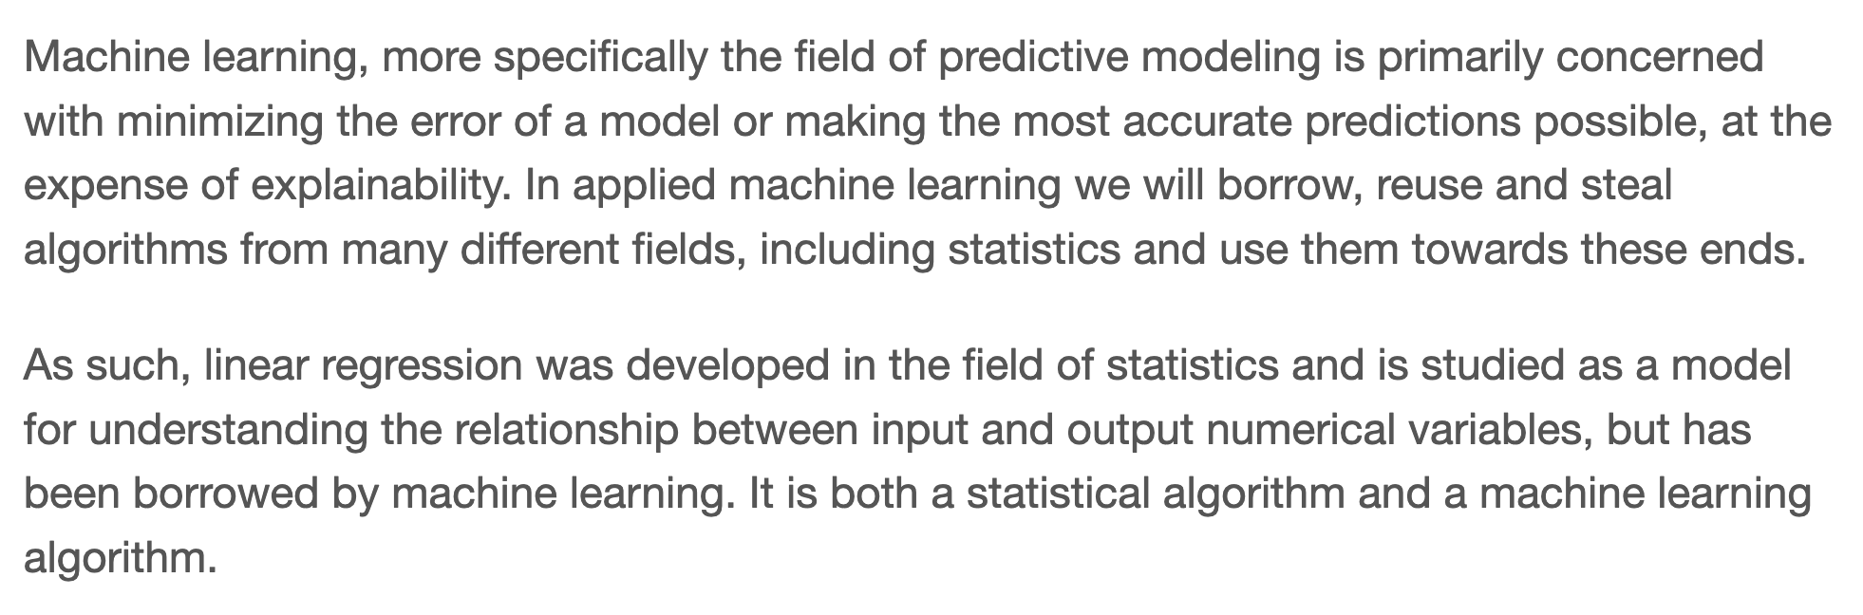
Linear Regression
Purdue University Global |Foundations of Purdue Global Culture
Notes:
https://en.wikipedia.org/wiki/Linear_regression#:~:text=In%20statistics%2C%20linear%20regression%20is,as%20dependent%20and%20independent%20variables).
https://machinelearningmastery.com/linear-regression-for-machine-learning/

Slide 12
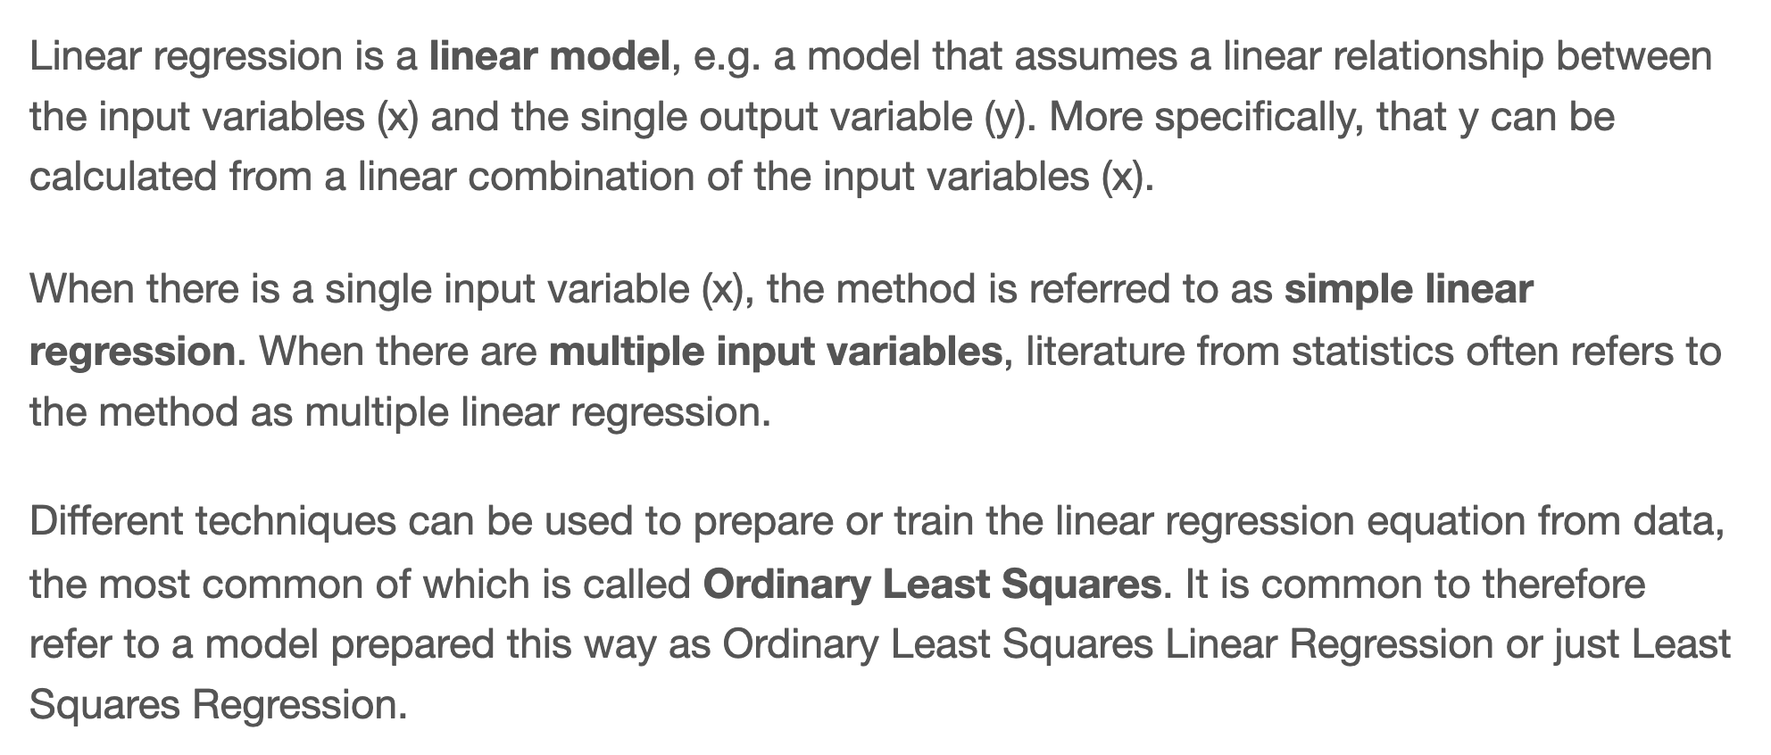
Linear Regression
Purdue University Global |Foundations of Purdue Global Culture
Notes:
https://machinelearningmastery.com/linear-regression-for-machine-learning/

Slide 13
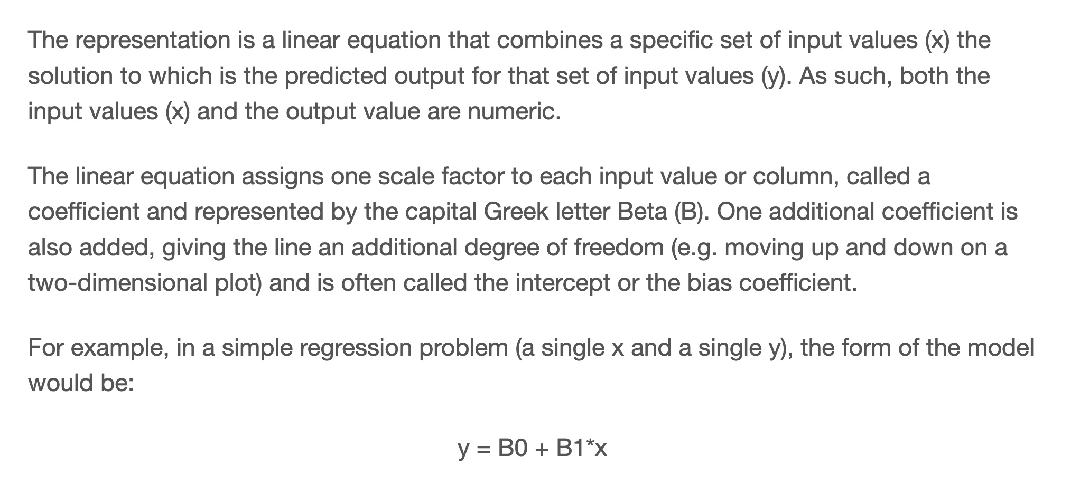
Linear Regression Equation
Purdue University Global |Foundations of Purdue Global Culture
Notes:
https://machinelearningmastery.com/linear-regression-for-machine-learning/

Slide 14
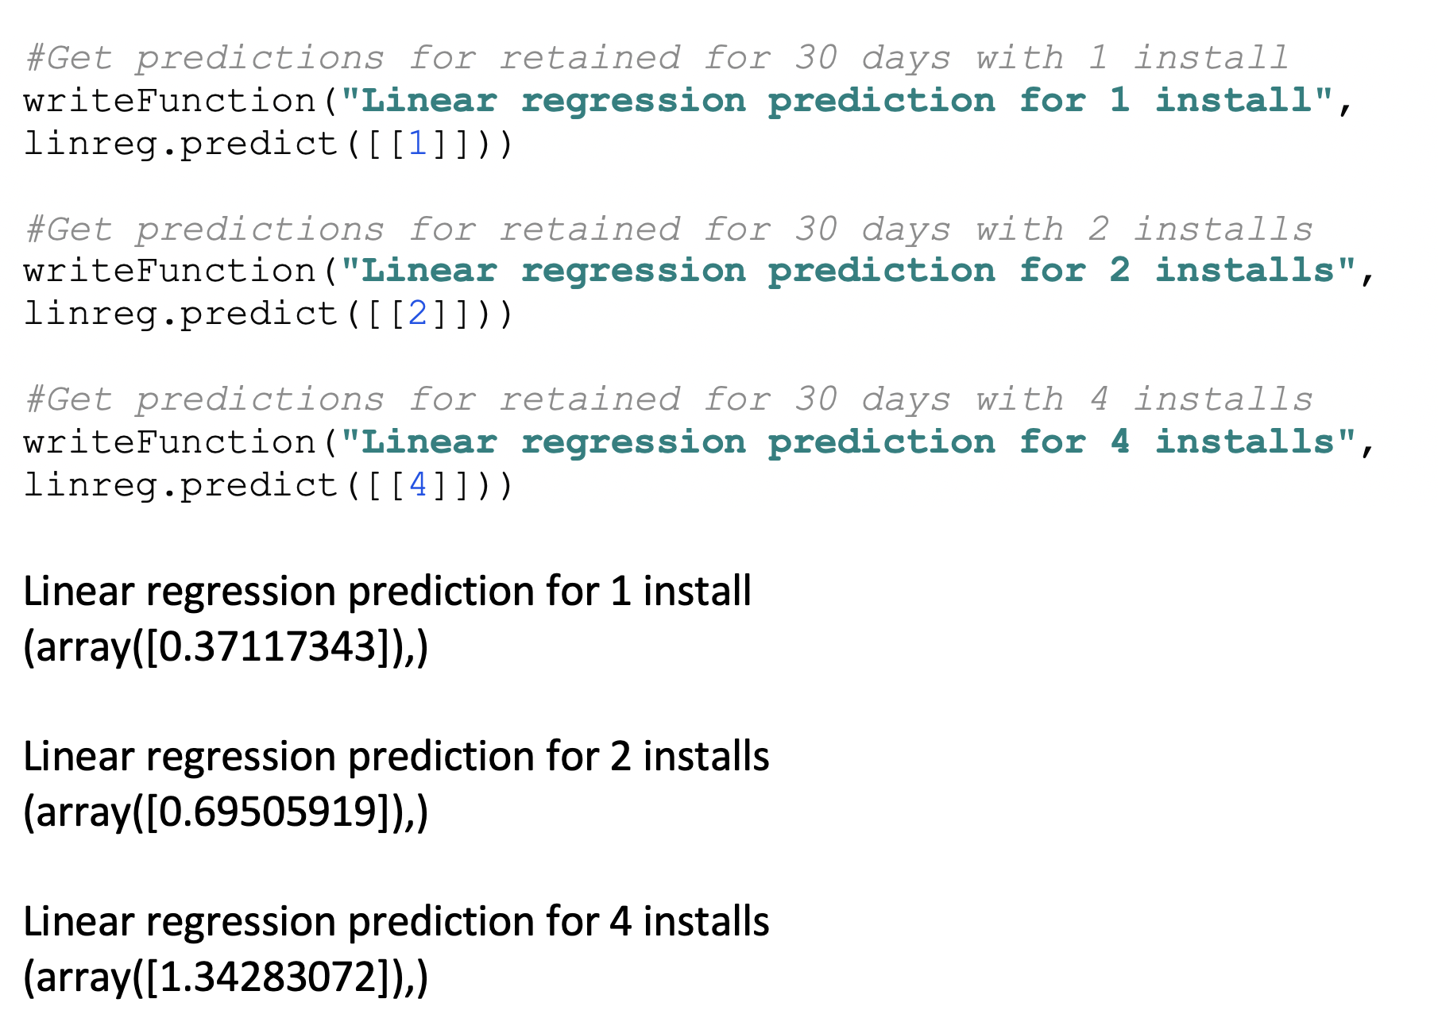
Predictions Using Linear Regression
Purdue University Global |Foundations of Purdue Global Culture

Slide 15
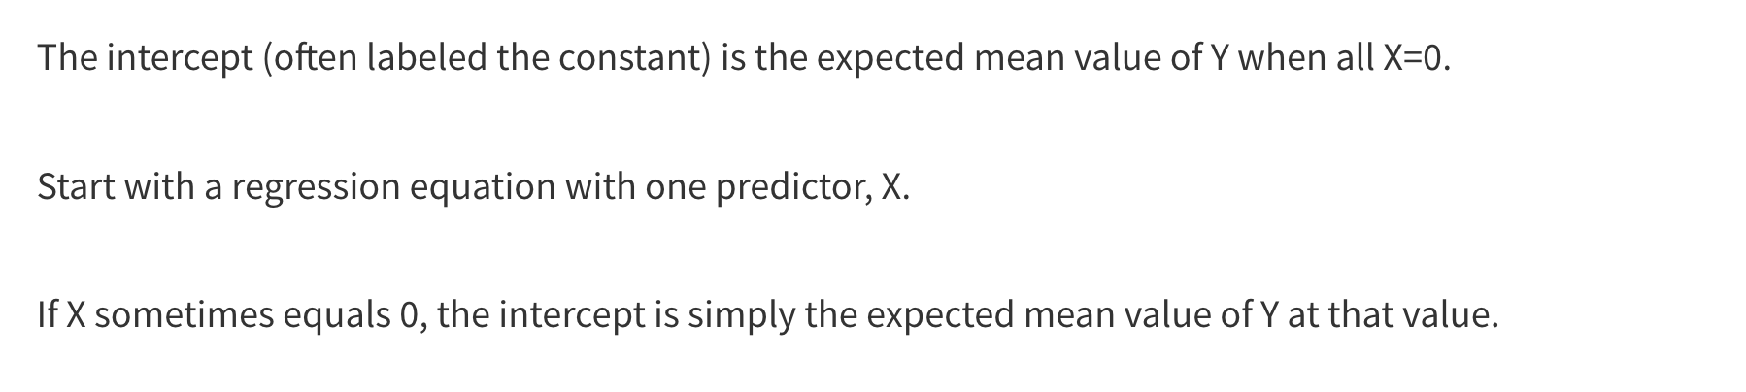
Regression Intercept
Purdue University Global |Foundations of Purdue Global Culture
Notes:
https://www.theanalysisfactor.com/interpreting-the-intercept-in-a-regression-model/#:~:text=The%20intercept%20(often%20labeled%20the,of%20Y%20at%20that%20value.

Slide 16
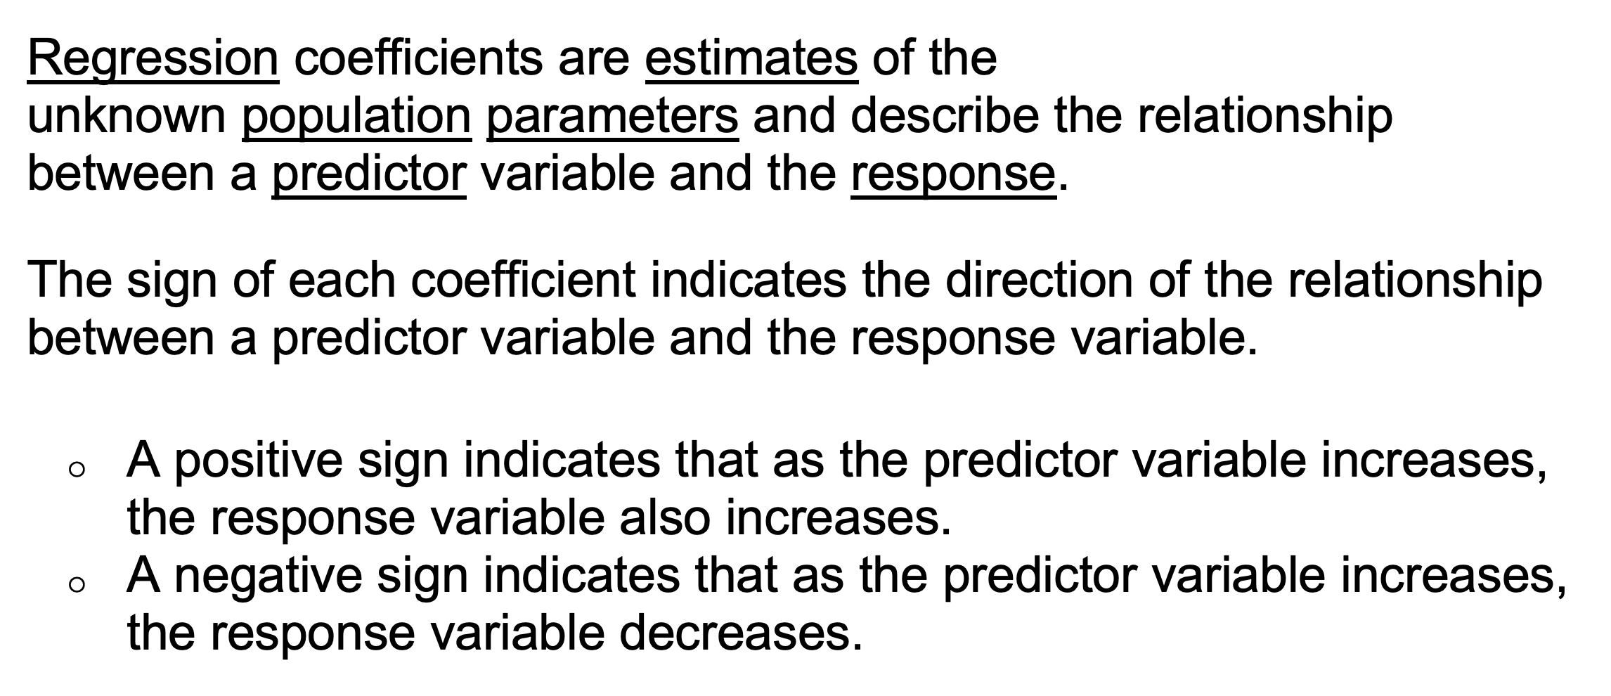
Regression Coefficients
Purdue University Global |Foundations of Purdue Global Culture
Notes:
https://statisticsbyjim.com/glossary/regression-coefficient/#:~:text=In%20linear%20regression%2C%20coefficients%20are,%3A%20y%20%3D%203X%20%2B%205.&text=The%20sign%20of%20each%20coefficient,variable%20and%20the%20response%20variable.

Slide 17
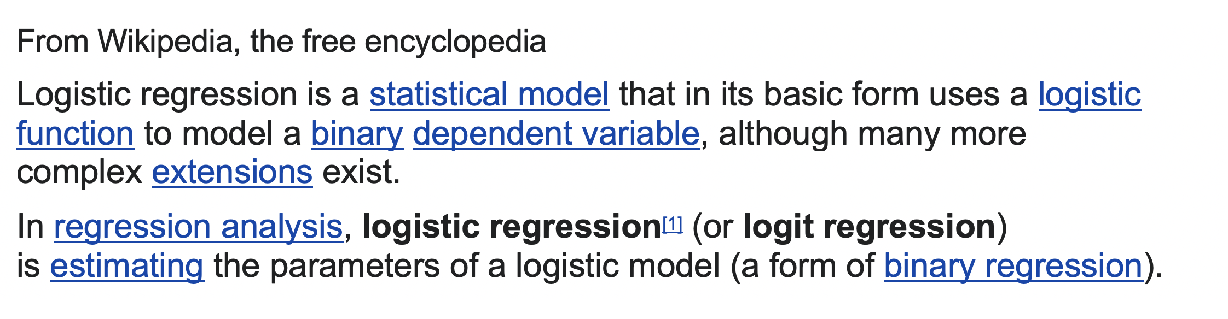
Logistic Regression
Purdue University Global |Foundations of Purdue Global Culture
Notes:
https://en.wikipedia.org/wiki/Logistic_regression#:~:text=Logistic%20regression%20is%20a%20statistical,a%20form%20of%20binary%20regression).

Slide 18
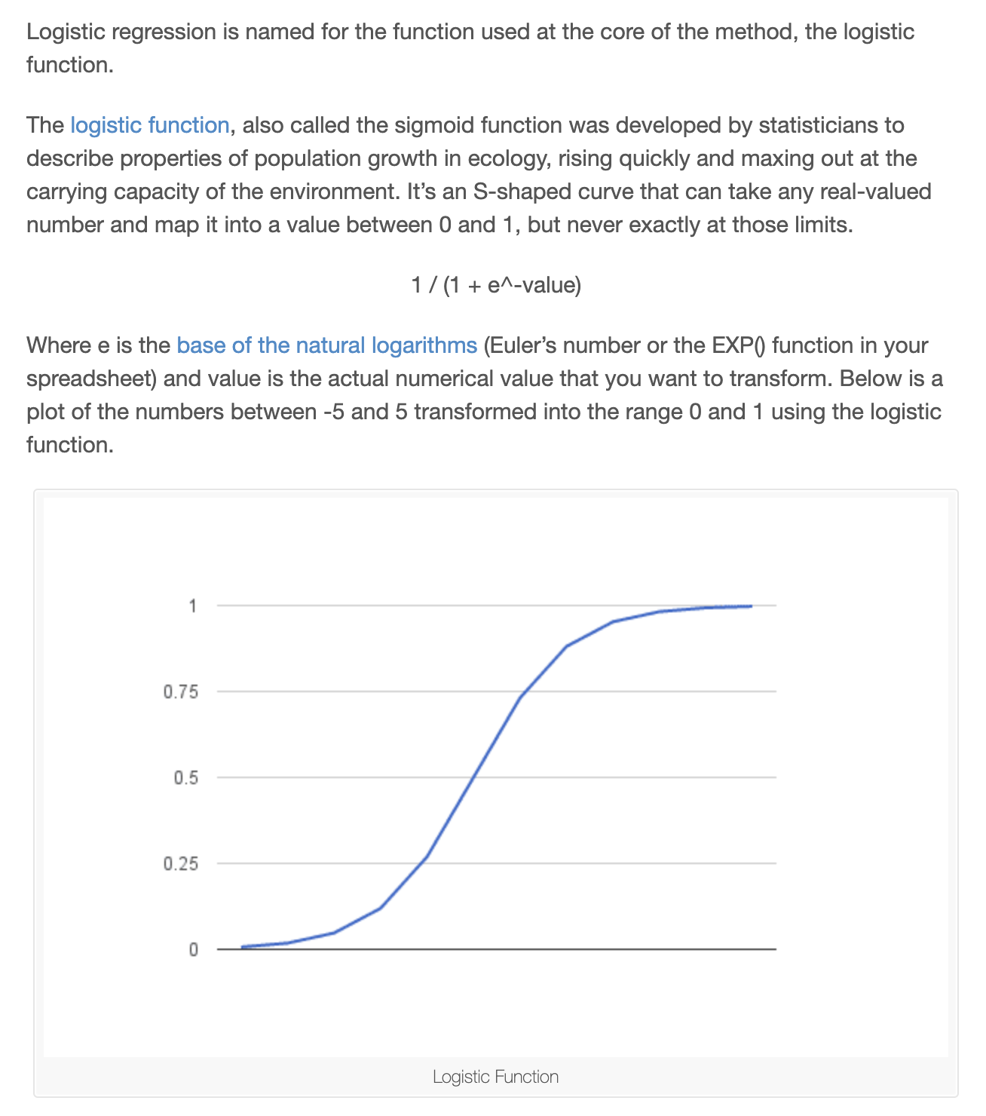
Logistic Regression
Purdue University Global |Foundations of Purdue Global Culture
Notes:
https://machinelearningmastery.com/logistic-regression-for-machine-learning/

Slide 19
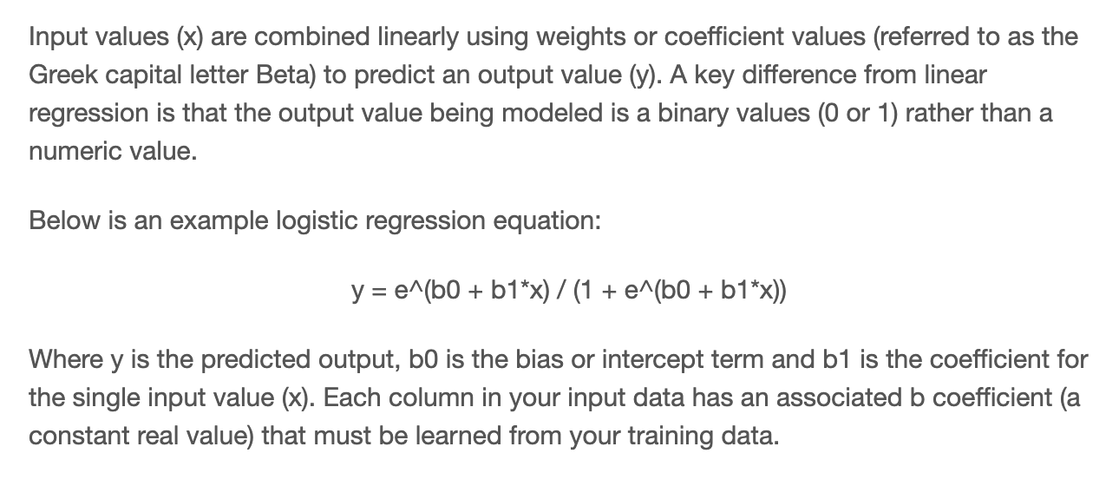
Logistic Regression Equation
Purdue University Global |Foundations of Purdue Global Culture
Notes:
https://machinelearningmastery.com/logistic-regression-for-machine-learning/

Slide 20
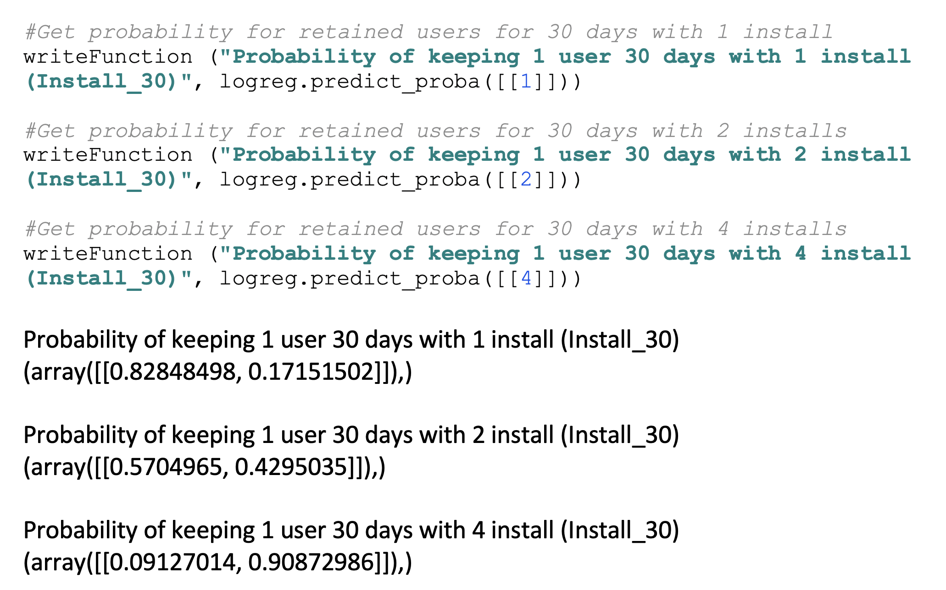
Probability
Purdue University Global |Foundations of Purdue Global Culture

Slide 21
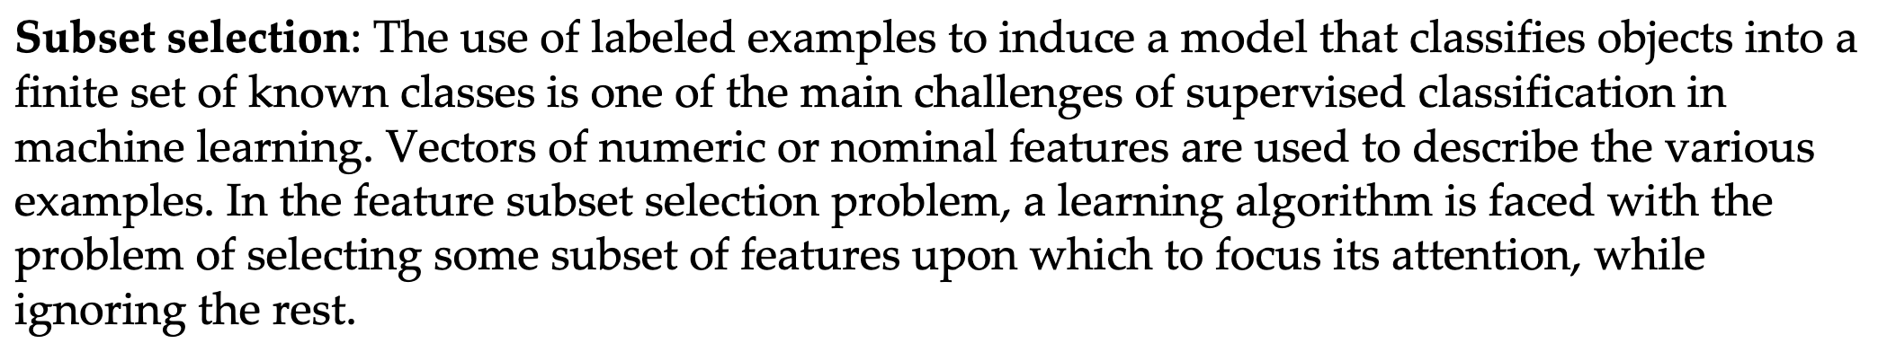
Model Selection and Regularization
Purdue University Global |Foundations of Purdue Global Culture

Slide 22
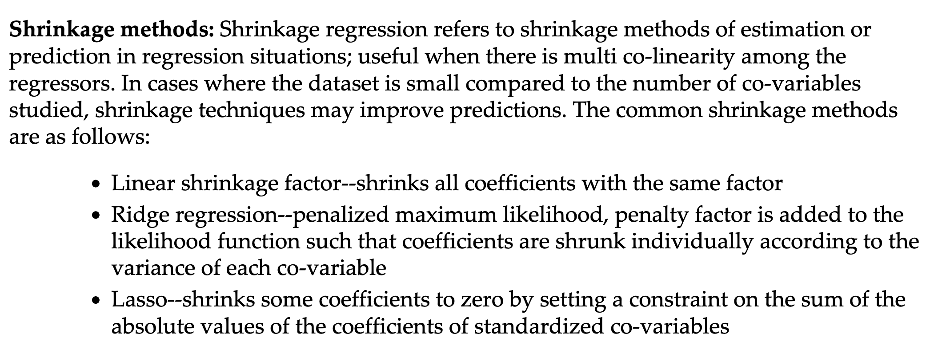
Model Selection and Regularization
Purdue University Global |Foundations of Purdue Global Culture

Slide 23
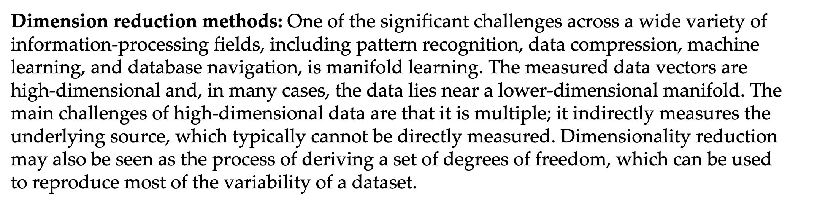
Model Selection and Regularization
Purdue University Global |Foundations of Purdue Global Culture

Slide 24
Code Example Walkthrough
Purdue University Global |Foundations of Purdue Global Culture

Slide 25
THANK YOU
Thank you for viewing the IN498 Unit 3 presentation. Please contact your instructor at robert.kayl@purdueglobal.edu with any questions.

